Slide 1
Lesson 3.10
Strategic Directions and Policies
CGPRT(W) : Ensuring Clean Seas and Coasts in Western Region ……

Slide 2
Objective
To understand the role of the administration and its senior management.
To understand the role of government in an oil spill.
CGPRT(W) : Ensuring Clean Seas and Coasts in Western Region ……

Slide 3
Response Strategy
Analyse hazards and
possible scenarios
Analyse
probabilities
Analyse
consequences
Characterize the risk
Risk
management
Options to
Options to
reduce
reduce
probability
consequences
CGPRT(W) : Ensuring Clean Seas and Coasts in Western Region ……

Slide 4
Response Strategy
Having identified the risks and the need for a contingency plan, we need to determine the response strategy.
Policy decisions should reflect:
local and national civil emergency arrangements
bilateral or regional undertakings
CGPRT(W) : Ensuring Clean Seas and Coasts in Western Region ……

Slide 5
Response Strategy
The key policy decision is who leads the response:
Government-led
Government directing the shipowner
Ship/facility owner-led, monitored by government
For the avoidance of doubt the role of government, industry and the shipowner's position must be made clear in the national plan
CGPRT(W) : Ensuring Clean Seas and Coasts in Western Region ……

Slide 6
Response Priorities
Response priorities must be established.
It is unlikely that all the resources at risk can be protected.
Vulnerable resources must be ranked according to their importance to the country and local community.
The desire to protect must take into account the practicalities of defence and protection.
CGPRT(W) : Ensuring Clean Seas and Coasts in Western Region ……

Slide 7
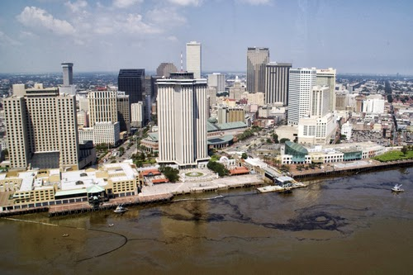
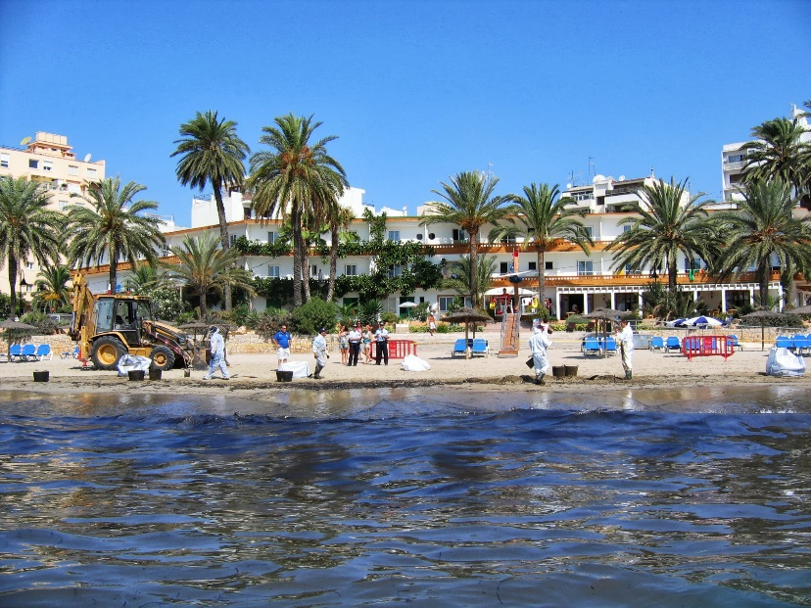
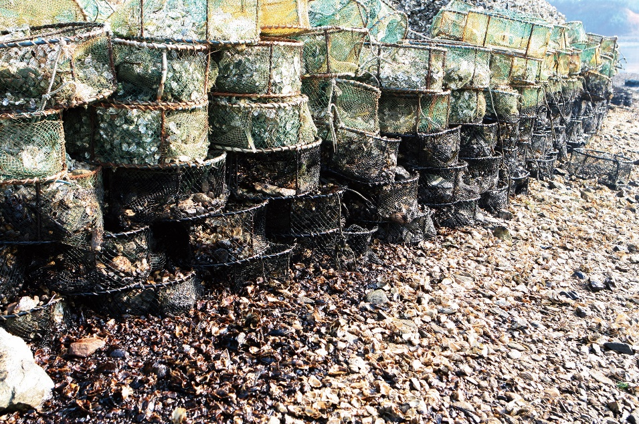
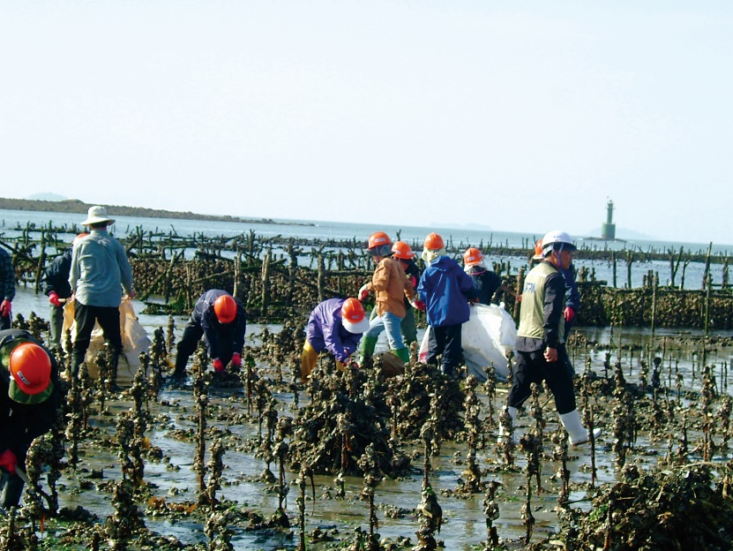
Response Priorities
CGPRT(W) : Ensuring Clean Seas and Coasts in Western Region ……

Slide 8
Response Priorities
The response priorities are for guidance.
They must be adaptable to the circumstances of the incident.
Any seasonal variations must be considered.
Sensitivity maps should be annotated with any known seasonal variances.
CGPRT(W) : Ensuring Clean Seas and Coasts in Western Region ……

Slide 9
Management Objectives
Performance targets:
  Operations at sea
  Shoreline clean-up
  Waste management
Who assesses performance?
Management issues?
Response objectives: how clean is “clean”?
CGPRT(W) : Ensuring Clean Seas and Coasts in Western Region ……

Slide 10
Operations at Sea
What aerial reconnaissance, surveillance and aerial coordination resources are available?
Effectiveness of mechanical recovery in current and forecast weather and sea conditions
Is there a policy on dispersant use?
Is there a policy on in situ burning?
Is there a “correct” option?
CGPRT(W) : Ensuring Clean Seas and Coasts in Western Region ……

Slide 11
Operations at Sea
Is there sufficient equipment?
Are there sufficient trained and experienced response personnel?
Is the performance of equipment acceptable?
Are there suitable vessels available?
Logistical challenges of keeping vessels at sea
When to seek external assistance bearing in mind the mobilization time?
CGPRT(W) : Ensuring Clean Seas and Coasts in Western Region ……

Slide 12
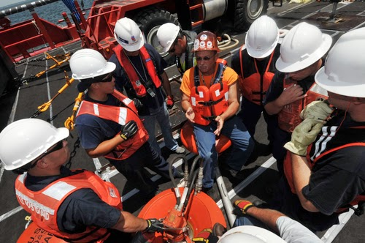
Operations at Sea
CGPRT(W) : Ensuring Clean Seas and Coasts in Western Region ……

Slide 13
Shoreline Clean-up
Experience of past spills as a measure of what can be expected
Determining the need for clean-up – and to what extent
Setting priorities
Selecting appropriate techniques
Setting and monitoring targets
Safe working conditions
Termination criteria
CGPRT(W) : Ensuring Clean Seas and Coasts in Western Region ……

Slide 14
Clean-up Objectives
Restore environment to a pristine level?
Restore environment to its pre-spill use?
Leave it alone?
Pre-spill condition data is very useful as a benchmark
CGPRT(W) : Ensuring Clean Seas and Coasts in Western Region ……

Slide 15
Shoreline Clean-Up
Recovery of high volumes of oil in the beginning
As clean-up progresses quantities are decreasing
At some point the efforts to remove oil are disproportionate to the benefits.
Oil Recovered
Clean-up Effort
CGPRT(W) : Ensuring Clean Seas and Coasts in Western Region ……

Slide 16
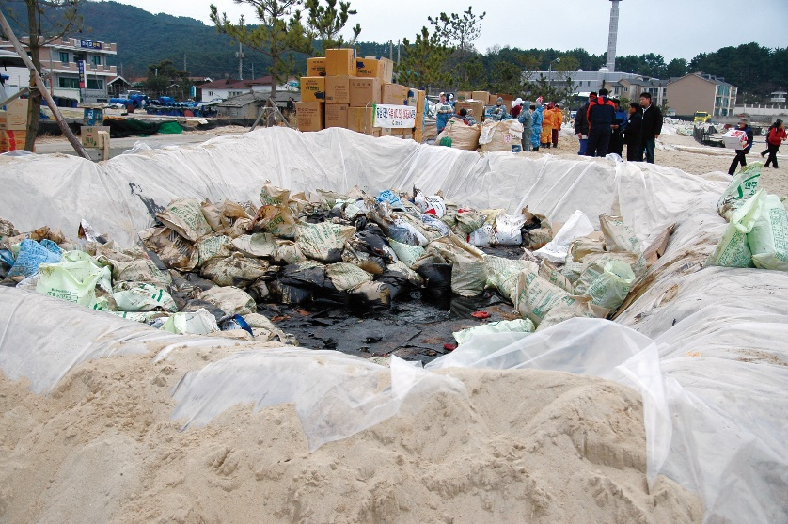
Waste Management
Is waste segregation effective?
Are there sufficient means of transport?
Are “clean” wastes being reused?
Are there adequate facilities for “dirty” wastes?
Are there regulatory controls over waste disposal?
CGPRT(W) : Ensuring Clean Seas and Coasts in Western Region ……

Slide 17
Management Issues
Who assess performance?
Senior management team
Incident Commander
Team leaders (at sea/on shore)
What is the division of responsibilities of the senior management team and the Incident Commander?
Are they clearly defined?
Strategic vs. tactical
CGPRT(W) : Ensuring Clean Seas and Coasts in Western Region ……

Slide 18
Policy Issues
Fishing bans
Bathing bans
Public health issues
Net Environmental Benefit Analysis (NEBA)
Use of vessels of opportunity
Use of volunteers
CGPRT(W) : Ensuring Clean Seas and Coasts in Western Region ……

Slide 19
Fishing Bans
Protection of human health?
Avoiding contamination of fishing boats?
Is a ban justifiable?
Compensation for loss of earnings
Who decides?
Shellfish or free-swimming fish?
Criteria for imposing and then lifting bans
How do you police the ban?
CGPRT(W) : Ensuring Clean Seas and Coasts in Western Region ……

Slide 20
Bathing Bans
Restrictions on public’s freedom of movement
Interference with clean-up response
Need to liaise with other authorities?
Public health hazards
Who decides?
Criteria for imposing and then lifting bans
How do you police the ban?
CGPRT(W) : Ensuring Clean Seas and Coasts in Western Region ……

Slide 21
Public Health Issues
What is acceptable level of risk?
  Risks of explosion
  Inhalation of fumes
  Skin disorders
Contaminated fish – bans?
Aquaculture products – bans?
Compensation for personal injury
Who decides?
CGPRT(W) : Ensuring Clean Seas and Coasts in Western Region ……

Slide 22
What is NEBA?
What is NEBA:
  Balancing the advantages and disadvantages of different response options with the aim of minimizing the overall impact on environmental and economic resources and reducing the time for recovery of affected resources by achieving an acceptable standard of clean-up.
  Common sense
CGPRT(W) : Ensuring Clean Seas and Coasts in Western Region ……

Slide 23
What is NEBA?
What NEBA is not:
  Not new
  Not complicated
  Not a means of calculating the net environmental benefit (i.e. not quantitative)
  Not a ‘Cost-Benefit’ Analysis
CGPRT(W) : Ensuring Clean Seas and Coasts in Western Region ……

Slide 24
NEBA in Practice
Evaluation of the options includes:
  Reference to previous information on the area (contingency plans)
  Reference to relevant oil spill case histories and experiments
  Consideration of the shoreline sensitivity
  Consideration of ecological resources
  Consideration of economic resources
  All parties must accept that some compromise may be necessary.
CGPRT(W) : Ensuring Clean Seas and Coasts in Western Region ……

Slide 25
Strategy Summary
Response strategy
Response priorities
Management objectives
Clean-Up objectives
Policy issues
NEBA
CGPRT(W) : Ensuring Clean Seas and Coasts in Western Region ……

Slide 26
Summary
In this lesson we have considered:
the role of the administration and its senior management
the role of government in an oil spill
CGPRT(W) : Ensuring Clean Seas and Coasts in Western Region ……

Slide 27
Any questions?
CGPRT(W) : Ensuring Clean Seas and Coasts in Western Region ……

